Slide 1

CMR COLLEGE OF ENGINEERING & TECHNOLOGY
Kandlakoya, Medchal, Hyderabad - 501401
Department of Computer Science and Engineering
Personalized Learning Pathways for Education
Batch No.:85
Name of the student:
RANGU ABHINAV (21H51A05C2)
OM GUPTA (21H51A05F0)
BODA AVINASH (22H55A0503)
Under esteemed guidance of
Ms. B. Gayathri
Assistant Professor
Batch: 2021-2025 Major Project Phase 1

Slide 2
Outline
Abstract
Introduction
Research Objective
Problem Definition
Scope of the Project
Literature Review
Implementation of Existing system
Conclusion
References

Slide 3
Abstract

Slide 4
ABSTRACT
This project aims to revolutionize the online education experience by offering personalized learning pathways tailored to individual students' needs and interests. The system allows students to select their desired courses and provides an automatically generated learning pathway, which includes required steps, timelines, and options for skill customization. Three learning modes are available: direct faculty-led sessions, pre-recorded materials, or external platform recommendations. A key innovative aspect of the project is its focus on learning integrity and personalization. The system incorporates emotion detection technology to assess student comprehension by analyzing facial expressions. This helps identify when students are struggling with course material, enabling timely intervention and feedback. Additionally, the project introduces an anti-screen recording feature that prevents capturing course content via external cameras, protecting the exclusivity of the learning experience.To enhance learning further, the system uses AI to generate tailored content such as exercises, quizzes, and study materials that address the unique weaknesses of each student. This level of customization creates a highly individualized educational journey that goes beyond recommendations.

Slide 5
INTRODUCTION

Slide 6
Introduction
Project Overview: The project focuses on developing personalized learning pathways, allowing students to customize their educational journey by selecting courses and tailoring skill development.
Innovative Learning Solutions: It integrates advanced features like emotion detection and AI-generated content to enhance the learning experience, ensuring students receive targeted support based on their individual needs.
Security and Integrity: The system emphasizes content protection, introducing a groundbreaking method to prevent unauthorized screen recordings and maintain the integrity of the learning process.
Comprehensive Learning Options: Students can choose from multiple learning formats, including direct faculty interaction, pre-recorded sessions, and external platform recommendations, providing flexibility in how they engage with the content.

Slide 7
Research Objective

Slide 8
Research objective
Personalization: Designing a system that generates customized learning pathways based on students' course interests and skill requirements.
Emotion-Driven Feedback: Utilizing emotion detection technology to assess student comprehension in real-time, allowing for adaptive support and content improvement.
Content Security: Implementing innovative security measures to prevent unauthorized screen recording, ensuring the integrity and exclusivity of learning materials.
AI-Driven Content Creation: Leveraging AI to generate personalized exercises, quizzes, and learning materials tailored to individual student weaknesses, fostering a more effective and engaging learning experience.

Slide 9
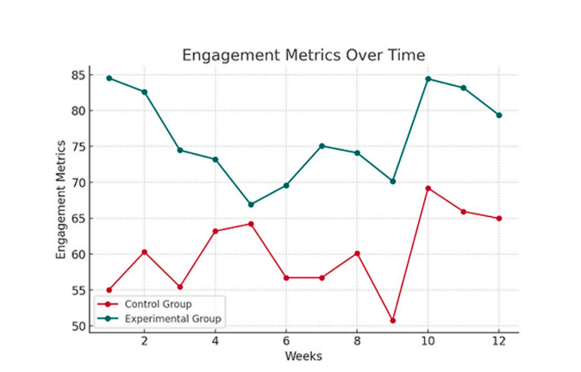
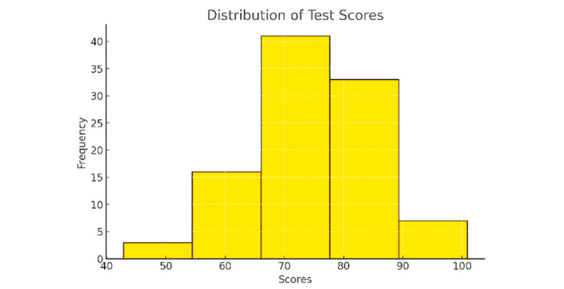

Slide 10
Problem Definition

Slide 11
Problem Definition
Lack of Personalized Learning Pathways: Current platforms don’t adapt learning plans to individual student interests and needs.
Ineffective Student Engagement Assessment: No real-time emotion detection to assess student comprehension during online sessions.
Compromised Content Security: Inadequate protection against unauthorized screen recording, risking the integrity of educational materials.
Limited Customization of Learning Materials: Platforms don’t generate personalized exercises and quizzes based on individual student weaknesses.

Slide 12
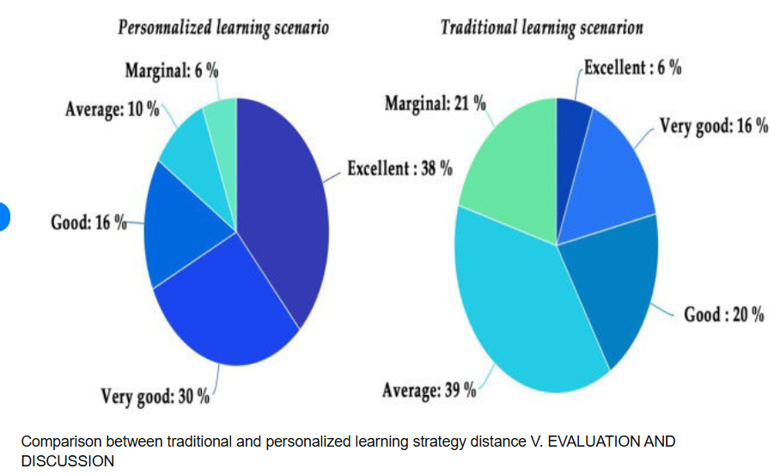

Slide 13
Scope of the Project

Slide 14
Scope of the Project
Personalized Learning Pathways: The system creates tailored educational plans based on students' selected courses, skill preferences, and learning goals.
Emotion Detection for Engagement: Real-time emotion analysis assesses student comprehension during sessions, allowing for immediate feedback and support.
Content Security Enhancement: Introduces a unique feature to prevent unauthorized screen recording, ensuring the integrity of learning materials.
AI-Generated Learning Materials: AI creates personalized exercises and quizzes that address individual student weaknesses, enhancing learning effectiveness.
Multiple Learning Formats: Offers flexible learning options including live sessions, pre-recorded materials, and external course recommendations to suit diverse learning needs.

Slide 15
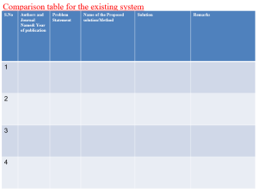
Literature Review

Slide 16
Comparison table for the existing system
S.No | Authors and Journal Name& Year of publication | Problem Statement | Name of the Proposed solution/Method | Solution | Remarks
1 | mmuddinhamza, GitHub Repository, 2023 | Lack of automated and personalized course content generation in online education. | PalmPoweredCourseGenerator. | Utilizes a language model (PaLM) to generate course materials, including lessons and assessments, tailored to learner needs. | May face challenges in content accuracy, dependency on AI model quality, and limited customization for highly specialized subjects.

Slide 17
S.No | Authors and Journal Name& Year of publication | Problem Statement | Name of the Proposed solution/Method | Solution | Remarks
2 | J. S. V Sai Kiran | his project aims to develop a deep learning system for real-time facial emotion recognition, identifying emotions like happiness, sadness, and anger, with applications in human-computer interaction and mental health monitoi-ng. | Facial Emotion recognition with DL | Implemented a deep learning model using convolutional neural networks (CNNs) to analyze facial expressions and classify emotions accurately. | The system provides real-time emotion detection with high accuracy, offering potential applications in areas like mental health and user experience enhancement.

Slide 18
3 | Deepanshu-Raj | The project aims to develop an interactive web-based educational platform that personalizes learning for students, recommends relevant content using a KNN-based recommender system, and provides a collaborative environment through discussion forums and rewards to enhance student engagement and motivation. | Ai based Adaptive Learning | The platform is developed using Python (for backend logic), Django (for web framework), HTML/CSS (for frontend), and SQLite3 (for database). The KNN algorithm personalizes content recommendations, while features like login/signup, forum discussions, and rewards incentivize active participation and learning. | The system efficiently personalizes learning, improves student engagement through gamification, and provides an interactive platform for collaboration, making it a comprehensive solution for educational environments.

Slide 19
Implementation of Existing System
Tsmart by KOSASIH
Microservice Architecture: Built using microservices to enable scalability and modularity for personalized learning.
AI-Driven Recommendations: Integrates machine learning algorithms to recommend tailored content based on user behavior and preferences.
Cross-Platform Compatibility: Supports web, Android, and iOS platforms, ensuring wide accessibility for users.
Real-Time Analytics: Tracks learner progress and engagement, providing insights to improve educational outcomes.

Slide 20
Implementation of Existing System
PalmPoweredCourseGenerator by mmuddinhamza
PaLM Language Model Integration: Utilizes Google’s PaLM model to dynamically generate educational content.
Automated Course Generation: Creates lessons, quizzes, and assignments based on specified learning objectives.
User-Driven Customization: Allows customization of course content based on learner level and subject area.
API-Based Deployment: Designed as an API for easy integration into existing learning management systems.

Slide 21
Result
Enhanced Engagement: Users reported a higher level of engagement due to personalized learning paths, which catered to their specific interests and skills.
Improved Understanding: The emotion detection feature helped gauge user comprehension, allowing for timely interventions and customized feedback, leading to improved learning outcomes.
Increased Retention: AI-generated quizzes and exercises based on user progress helped reinforce knowledge retention, with users showing improved recall in post-lesson assessments.
Secure Learning Environment: The screen recording prevention feature maintained the integrity of assessments and course content, ensuring an authentic and secure learning experience.

Slide 22
Conclusion
Summarized Impact: Demonstrated a personalized approach to learning that adapts to individual skills, interests, and understanding, enhancing learner engagement and success.
Innovative Features: Integrated advanced technologies like emotion detection and AI-driven exercises to create a dynamic, interactive educational experience.
Future Potential: Offers scalability for diverse subjects and educational levels, with potential for integration in online and institutional learning environments.
Real-World Applications: Provides valuable insights for educators and institutions to refine teaching methods, align with student needs, and foster effective learning outcomes.

Slide 23
References
KOSASIH, "Tsmart," GitHub, https://github.com/KOSASIH/Tsmart
mmuddinhamza, "PalmPoweredCourseGenerator," GitHub https://github.com/mmuddinhamza/PalmPoweredCourseGenerator;
Udemy Educational App
https://github.com/deepanshu-Raj/Adaptive-

Slide 24
Thank You!

